Slide 1


Slide 2
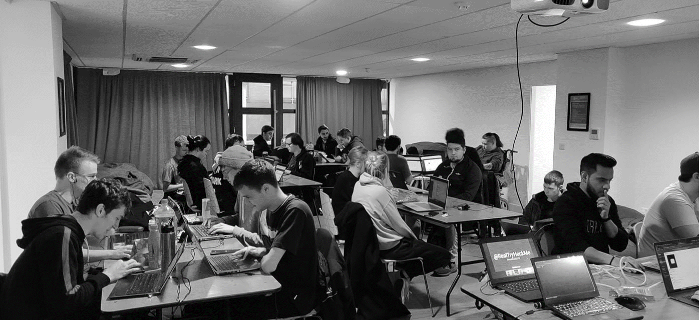



/dmuhackers
@dmuhackers
Web App Hacking

Slide 3



Disclaimer
Don’t do illegal shit

Slide 4
Overview
Going through some popular methods and tools to attack webapps
SQL Injection
XSS
Fuzzing
IDOR
File Inclusion
SSRF
Tools: Gobuster, BurpSuite, wpscan, Nikto
Practical: TryHackMe: Advent of Cyber 2 – Web Exploitation

Slide 5
SQL Injection
Allows you to get data from a database by escaping the existing SQL query and replacing it with your own.
Example:
'SELECT * FROM users WHERE username=<INPUT> AND password=<INPUT>'
'SELECT * FROM users WHERE username=' OR 1=1 -- - AND password=' OR 1=1 -- - '
Sqlmap used for automating many different SQLi types
Can also import requests directly into sqlmap to save time (e.g. Burp)

Slide 6
XSS
Cross-Site Scripting – Another form of command injection like SQLi, using JavaScript.
3 types: Reflected, Stored, DOM-based
Reflected: When data is shown back to the user (e.g. in a search bar)
Stored: When data is retrieved from a database, and an attacker's script is executed
DOM-Based – Where a client-side browser vulnerability is exploited, giving access to cookies, credentials, etc.
XSS Cheat Sheet: https://netsec.expert/posts/xss-in-2021/

Slide 7
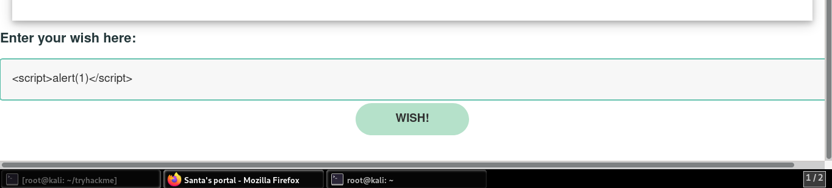
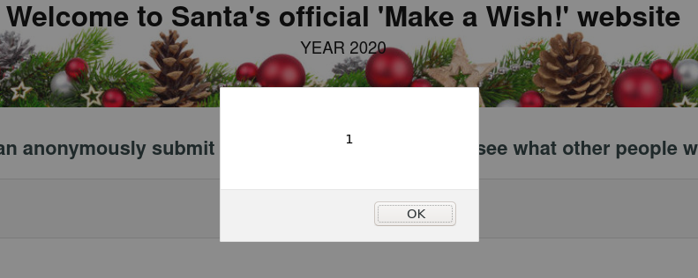
XSS

Slide 8

Fuzzing
Essentially bruteforcing – sending lots of requests to a server to see what works – using a wordlist (or not!)
Some examples of where fuzzing can be used:
Login pages
Upload sections
Identifying blacklists
Credentials
Finding scripts
Wfuzz – Installed on Kali by default

Slide 9
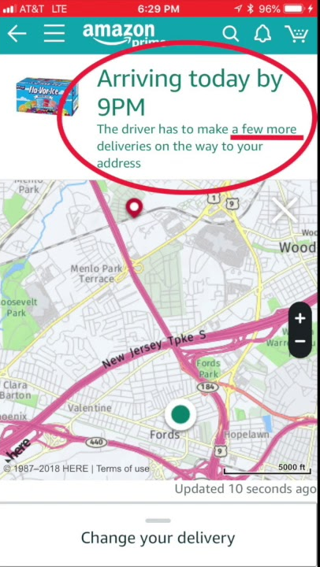
IDOR
Insecure Direct-Object Referencing
Using references to one object (such as an image) to guess references to other objects
Amazon were vulnerable to this, exposing people’s home addresses/locations because of the map image you get when tracking your package
Example:
Amazon.com/ordertracking/order1map.jpg
Amazon.com/ordertracking/order2map.jpg
Amazon.com/ordertracking/order(x)map.jpg

Slide 10
Local File Inclusion
When a webapp calls a file stored on the server, but the path can be changed by the user to access something unintended by the webapp
Can be used when a query parameter points to another file
Useful for executing shells
Example:
https://example.com?include=file.php
https://example.com?include=../../../etc/shadow
https://example.com?include=../uploads/shell.php

Slide 11
SSRF
Server-side Request Forgery
Where you can tell the web app (server) to make a separate web request as the web server
Can be used to request pages the user isn’t able to normally access (such as restricted subdomains)
Can also be used to scan the internal network the web server is connected to

Slide 12
Tools: Setup
Most of the tools in this session come pre-installed in Kali, but you might need to install/configure some of them yourselves.
Sudo apt install gobuster
Burp:
Install FoxyProxy in Firefox
Copy the settings from Burp > Proxy > Options into FoxyProxy (ensure both are running!)
Go to http://burp, and click “CA Certificate”.
Import this certificate into Firefox
You can now use Burp with HTTPS!

Slide 13

Tools: BurpSuite
Basically a one-stop-shop for web hacking
Manipulate and change packets before they get forwarded to the target – Proxy and Intercept
Fuzzing – “Intruder”
Examine requests/responses in-depth – “Repeater”
Can also encode request parameters with various methods (web-encoding, base64, etc.) within BurpSuite
For more on what Burp can do: https://ippsec.rocks and search “Burp”

Slide 14
Gobuster
Used to discover hidden directories of a website, using a wordlist. Makes a note of which directories yield a 200 (OK) instead of a 404 (Not Found)
Example command: gobuster dir -h
Gobuster dir –u http://webapp/ -w /usr/share/wordlists/dirbuster/directory-list-2.3-medium.txt
(May have to use –r if redirects are causing gobuster to play up)

Slide 15
Wpscan
Vulnerability scanner specifically for Wordpress sites
Included because of how many sites (still) use it
Can scan for vulnerable plugins, themes etc. which may have a publicly-available exploit. Very good for enumeration.
Example command: wpscan -h
Wpscan --url http://webapp.com –e u,vp,vt --detection-mode aggressive
Looks for first 10 users, and any vulnerable plugins or themes

Slide 16
Nikto
General-purpose web-app vulnerability scanner, comes in Kali
Good to just throw this at a webapp and see if it finds anything, so you always have recon going on while you’re looking into other things
Can automate checks for a variety of vulnerabilities such as SQL Injection and XSS

Slide 17
Questions
Any questions?

Slide 18
Practical
Advent of Cyber 2: Days 1-6
https://tryhackme.com/room/adventofcyber2
Recommended:
Learn Burp Suite: https://tryhackme.com/room/learnburp
XSS in detail: https://tryhackme.com/room/xss
Basic webapp box: https://tryhackme.com/room/vulnversity

